Slide 1
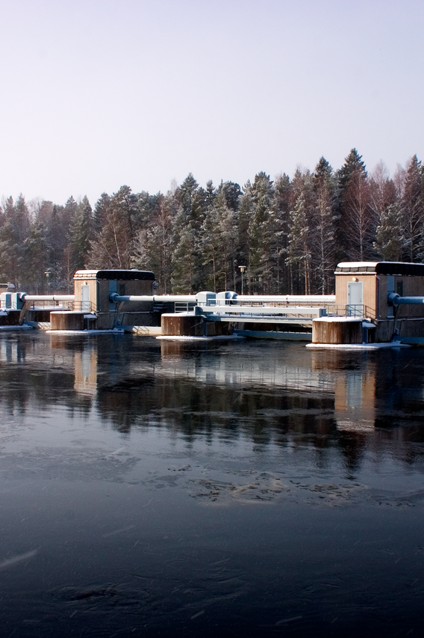

Place this purple overlay over the image on the right.
HYDRO POWER | SWEDEN
Vattenfall standardizes asset framework and AVEVA™ PI System™ Point structures by using SDK
Challenge
Old AVEVA PI System structure built up over long time
Geographically spread out with strong local focus
Transition from focus on technicians to use by analysts
Solution
Creation of SDK scripts to create a well templatised asset framwork structure, PI Point naming and ensure a fleet wide comparable data quality.
Results
Standardized asset framework structure with 150 turbines and 40.000 PI Points
PI System team’s increased ability to support new business cases
Reduced time spent on developing and maintaining PI asset framework templates and time on implementation of new sensors
Increased capacity by enabling fleet wide analysis and comparisons and use of CBM in the organization
Learn more
Notes:
Guidelines for completing this summary slide
We are asking all our customer presenters to create a summary slide in this format please. We kindly ask you not to change the format or the text size as we want everyone to be able to see the words.
Slide 2 provides an EXAMPLE of a completed slide.
INDUSTRY – please enter the industry that defines what your business does. Upper case.
LOCATION – please enter the country or region in which the solution is used. Use the term GLOBAL if relevant. Upper case.
HEADING – start with the name of your organisation and use a short sentence to describe the value the solution brings to your business. Use the present tense. Two lines of text max. No full stop (period).
E.g. ABC reduces operating costs and is on-track to be net-zero by 2030
CHALLENGE – outline the challenges you were facing and the manifestation of the pain. Use succinct language. Use the past tense. No full stops (periods).
E.g. Annual storms threatened the stability of the grid, causing power outages for customers and putting repair crews at risk
SOLUTION – summary of the technology, overall solution and approach. Two sentences on three lines max. Include full AVEVA product names.
RESULTS – outline the outcomes in terms of the value delivered to your business. Include metrics if they are available (e.g. % savings, reduction in person-hours, cost savings, % improvements, waste reduction etc.)
Align with the pains outlined in the CHALLENGE section. Include human tangibles also. Begin each point with a past tense verb.
E.g.
Reduced waste by 6%
Cut emissions by 19%
Prevented three plant shutdowns in the first year, saving $millions.
Created a safety-first culture
Increased morale and trust in data

