Slide 1

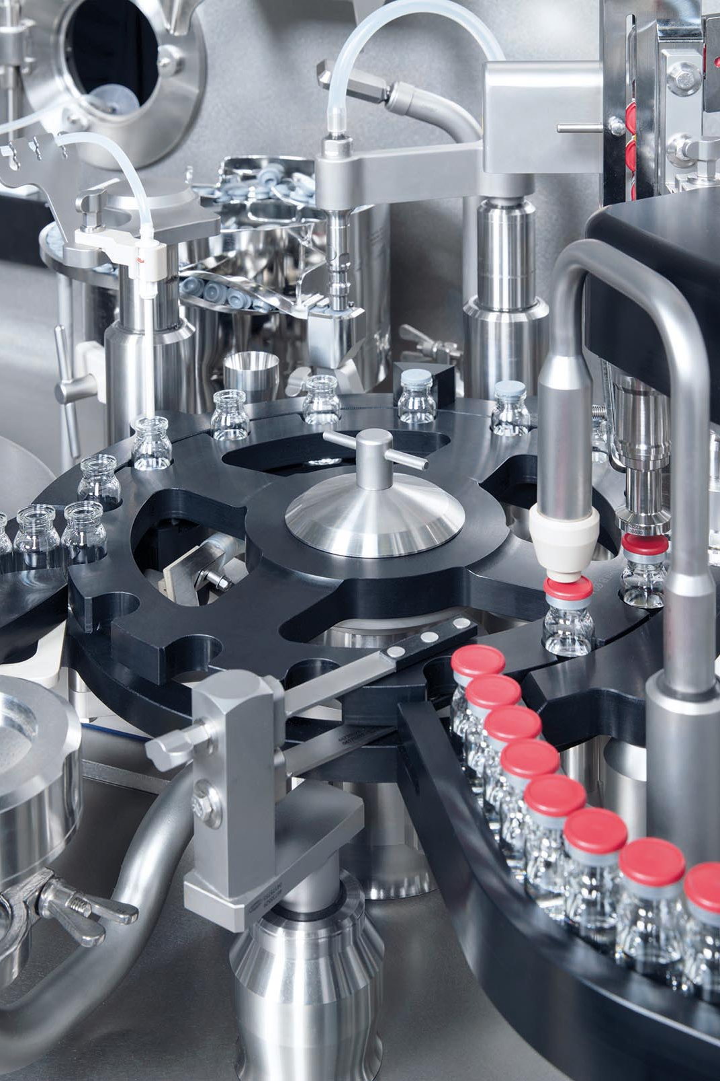
LIFE SCIENCES | GERMANY
Bausch+Ströbel provides condition monitoring-as-a-service with CONNECT
B+S clients faced recurring bearing failures on their packaging machines leading to costly downtime
Bearing damage was very difficult to identify during machine assembly and could only be sporadically detected by highly specialized technicians. Once operational, these machines were not monitored for vibration data, making condition assessment and early failure detection difficult
B+S wanted to offer a value-added service to their clients to monitor and predict bearing failures for timely remediation and maintenance, so clients can minimize production downtime
Developed a solution where real-time and historical client sensor data is brought into CONNECT data services, and a bearing failure detection model is developed and tuned in AVEVA Advanced Analytics
Model results are provided to clients on visualization tools (IOTA Vue, PI Vision) for operationalization
Successful lighthouse project with measurable reduction in bearing failures and machine downtime
Exploring additional functionality with streamlined data collection and model development, and conducting further trials with clients and service technicians

