Slide 1

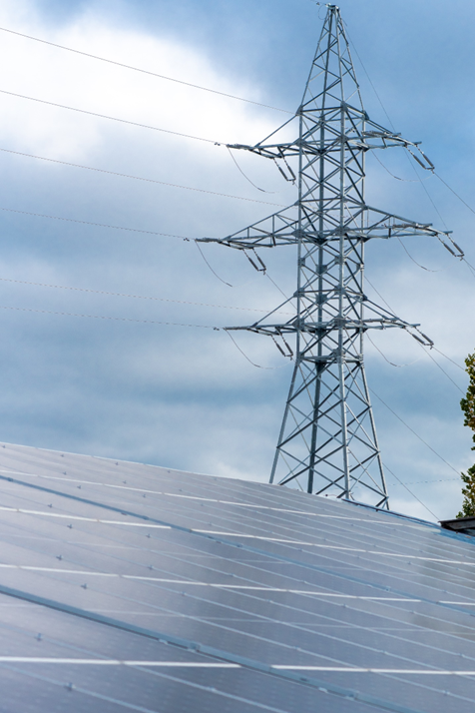
Place this purple overlay over the image on the right.
TRANSMISSION AND DISTRIBUTION | UNITED KINGDOM (UK)
UKPN prepares for a sustainable future as a DSO by increasing digitalization of its smart grid
Challenge
Be the best performing UK DNO and DSO
Allow for more flexibility on the grid for more DERs to be connected without impacting safety and network reliability
The requirements for DNOs to support DSOs need to develop and use their network more efficiently
Resource intensive data wrangling – too much data for skilled operatives to process in real time
Solution
Deployed AVEVA™ PowerRunner on AVEVA™ PI System™ to streamline data collection, access and advanced analytics focused on grid modernization.
Results
Single source of truth for OT/IT data and analytics
Advanced Analytics for RTU health, transformer load management, network connectivity, predictive failure
Improved planning data
Improved proactive maintenance of assets
Learn more
Notes:
UK Power Networks (UKPN) is an electrical distribution company that covers London, Southeast England, and East England covering 30,000 square kilometers and 8.2 M metered customers. As a leader in this market and responsible for one of the largest population centers in the world, UKPN is leading several project initiatives to meet the regulatory and market requirements including the digitalization of the grid. These efforts have led to the need for an operational data management and analytics system for Operational Technologies (OT) at an unprecedented scale. Each meter and device must be contextualized in an asset hierarchy as the relationship is key to make the data useful. To assist UK Power Networks on it journey, they have selected AVEVA’s PowerRunner on AVEVA PI System to be the data and analytics’ platform to assist in driving them to success during the increase of digitalization and DNO to DSO transition.

